Slide 1
Pipeline Combinators for Gradual AutoML
Guillaume Baudart, Martin Hirzel, Kiran Kate, Parikshit Ram, Avraham Shinnar, and Jason Tsay
IBM Research
Presentation at NeurIPS on 9 December 2021
https://github.com/IBM/lale

Slide 2
Manual Machine Learning
edit
Trainable Pipeline
(all choices of operations and hyperparameters are bound)
Trained Pipeline
Dataset
train
loop
Trained Pipeline (learnable coefficients are bound)
evaluate
Metrics
Pipeline = dataflow graph composed of multiple ML operations

Slide 3
Automated Machine Learning (AutoML)
AutoML
Planned Model (some choices of operations and hyperparameters are free)
generate
Search space (optimizers: Hyperopt, SMAC, Hyperband, GridSearch, …)
edit
acquire
Dataset
A ranked list
of trained pipelines
Trainable Model (all choices of operations and hyperparameters are bound)
decode
Point in search space
Optimization Metric
Constraints
loop
train
Trained Model (learnable coefficients are bound)
evaluate
Metrics

Slide 4
Automated Machine Learning (AutoML)
Planned pipeline (some choices of operations and hyperparameters are free)
generate
Search space (optimizers: Hyperopt, SMAC, Hyperband, GridSearchCV, …)
edit
acquire
Dataset
A ranked list
of trained pipelines
Trainable pipeline (all choices of operations and hyperparameters are bound)
decode
Point in search space
Optimization Metric
Constraints
loop
train
Trained pipeline (learnable coefficients are bound)
evaluate
Metrics

Slide 5
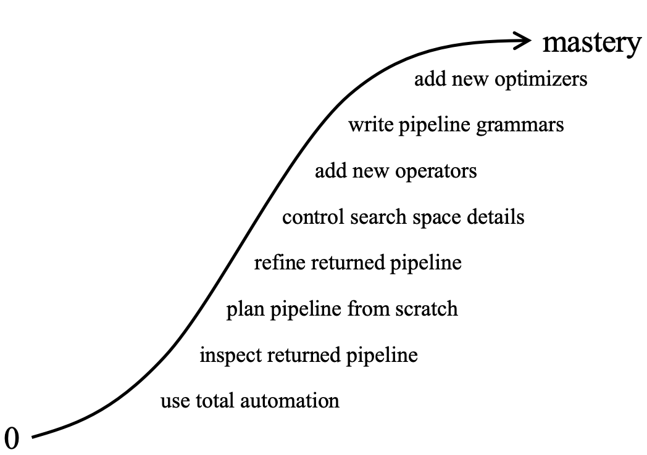
Programming Model for Gradual AutoML
Progressive disclosure
Start with a small subset of constructs, learn more as required for higher levels of control
Orthogonality
Minimize the number of independent constructs
Maximize compositionality for expressiveness
Principle of least surprise
Make each construct look and behave the way most users would expect

Slide 6
Total Automation
Four lines of code to run AutoML and find the best pipeline for a given task
The set of operators and the graph topology is pre-defined

Slide 7
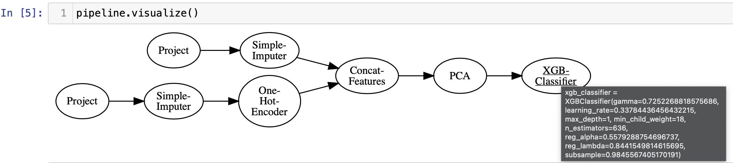
Inspect Pipelines
Visualize pipelines and inspect the hyperparameter values

Slide 8
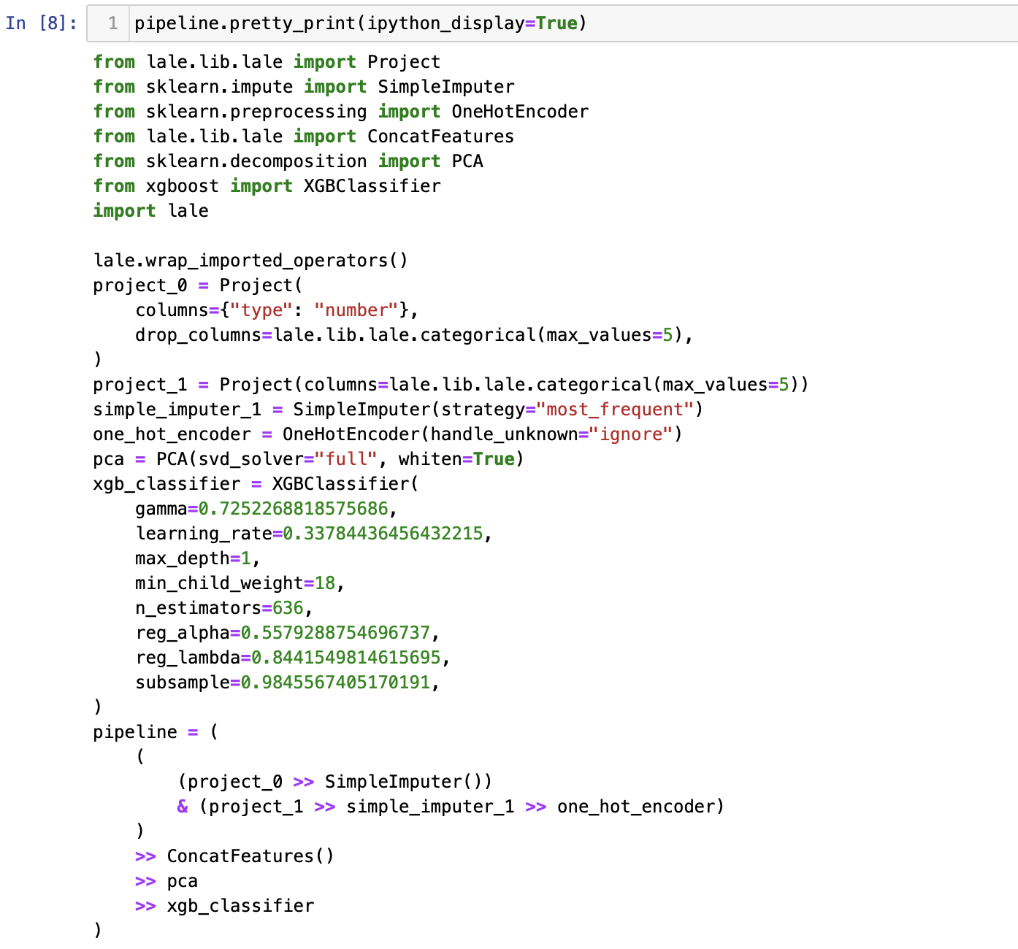
Inspect Pipelines
Get Python code as output by calling `pretty_print` on a pipeline object

Slide 9
Create a Pipeline from Scratch: Combinators
Functions that compose machine learning operators
Imported from functional programming
Enable a tacit programming style with function compositions independent of data
Three main combinators in Lale:
Combinator | Description
op3 = op1 >> op2 | pipe (add dataflow edge)
op3 = op1 & op2 | union (no added edge)
op3 = op1 | op2 | choice (AutoML picks one)

Slide 10
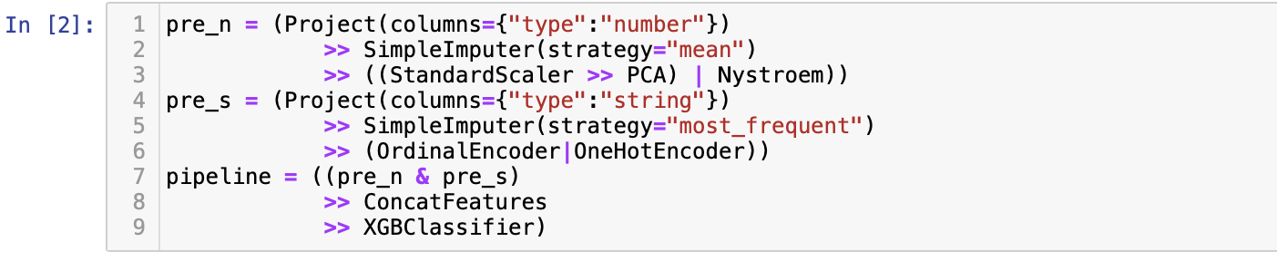
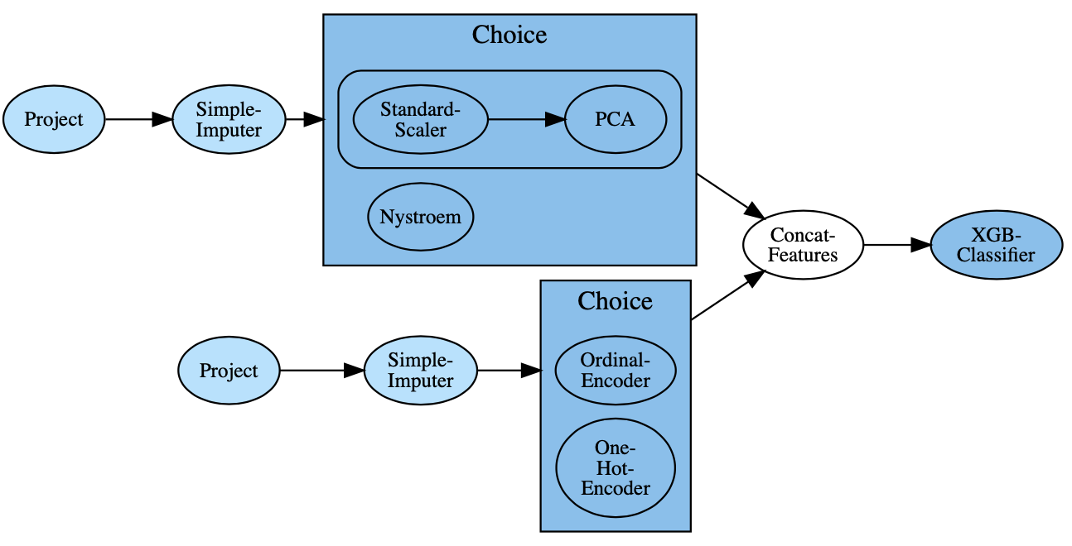
Create a Pipeline from Scratch: Combinators

Slide 11
Execution Modes
Fit and predict similar to Scikit-learn
Third execution mode for AutoML search:

Slide 12
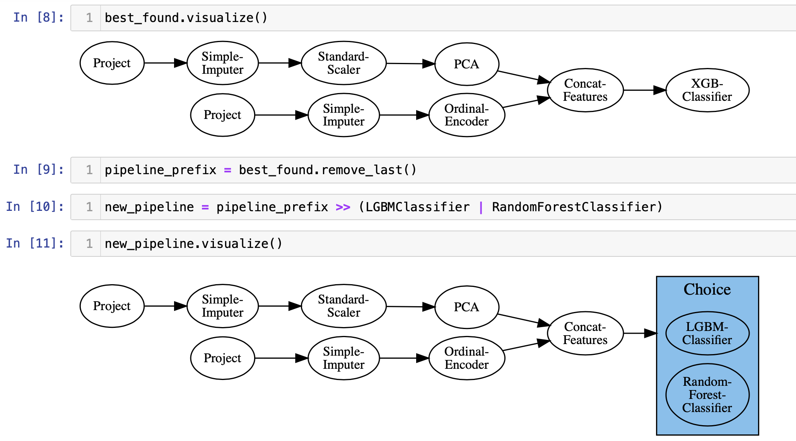
Refine a Pipeline
Functions which decompose a pipeline
Can be used with the combinators to refine pipelines

Slide 13
Search Spaces and Optimizers
edit
Planned pipeline (some choices of operations and hyperparameters are free)
generate
Search space (optimizers: Hyperopt, SMAC, Hyperband, GridSearchCV, …)
acquire
Dataset
Trainable pipeline (all choices of operations and hyperparameters are bound)
decode
Point in search space
loop
A ranked list
of trained pipelines
Optimization Metric
train
Trained pipeline (learnable coefficients are bound)
evaluate
Metrics
Constraints

Slide 14
Pipeline -> Search Space

Slide 15
Pipeline -> Search Space: Combinators
Combinators “glue” together operators.
We automatically ”glue” together individual search spaces appropriately.
Combinator | Description
op3 = op1 >> op2 | pipe (add dataflow edge)
op3 = op1 & op2 | union (no added edge)
op3 = op1 | op2 | choice (AutoML picks one)
More details in the paper

Slide 16
Hyperparameter (JSON) Schemas
PCA: {"type" : "object",
"properties” "n_components": { "anyOf": [ { "enum": [None, ["mle"]] }, { "type": "number", "minimum": 0.0, "exclusiveMinimum": True, "maximum": 1.0, "exclusiveMaximum": True, }, { "type": "integer", "minimum": 1
}, ], "default": None, }
}
SimpleImputer: {"type" : "object",
"properties": {
"strategy": {
"enum": ["constant ", "mean",
"median", "most_frequent"],
"default": "mean”},
"fill_value": { "anyOf": [
{"type": "number"},
{"type": "string"},
{"enum": [None]}],
"default": None,
}
We also support:
Description fields
Validation only specifications
Inter-parameter constraints
Data dependent specifications
Lists, tuples, and arrays
Nested operators
“Any”
…

Slide 17
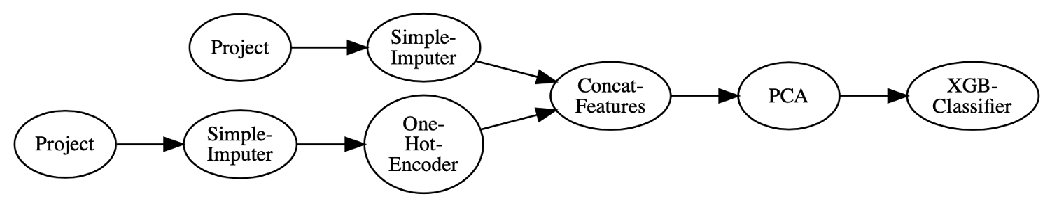
Operator Libraries
make_operator(implementation, schemas)
Lale currently has 216 operators from sklearn, imblearn, aif360, lightgbm, xgboost etc.
The operators can also be deep neural networks.
Papers at AutoML@ICML'20 and SecML@ICLR’21 on inferring schemas from documentation and static analysis of code.

Slide 18
Operator Grammars
Extends combinators to allow for recursion.
Enables pipeline topology search with a simple compact representation
Combinator | Description
op3 = op1 >> op2 | pipe (add dataflow edge)
op3 = op1 & op2 | union (no added edge)
op3 = op1 | op2 | choice (AutoML picks one)
g.op3 = … g.op3 … | Recursive reference

Slide 19
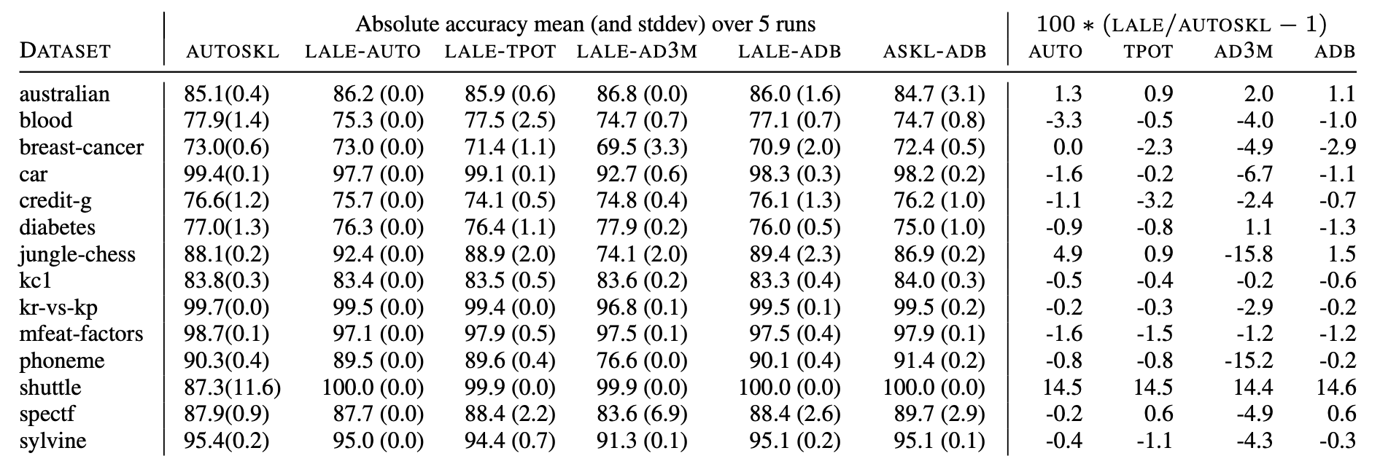
Experiments
Does the translation scheme work for diverse planned pipelines?
Does the translation scheme work for diverse optimizer backends?

Slide 20
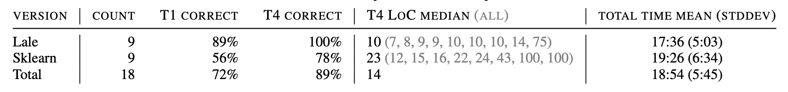
User Study
Between-subjects user study with 18 participants
Four tasks to compare Lale to Scikit-learn
The tasks covered basics of manual ML and AutoML

Slide 21


Lale
Library for semi-automated data science
https://github.com/IBM/lale

